Slide 1
Exploring the Real Estate Market
Data Analytics - Group Project
Group 4
Aishwarya Khinvasara
Nihal Jayan
Rahul Chada
Ruchika Balani
Swetha Srinivasan

Slide 2

Project Goals
Collect real estate data from different cities in SF Bay Area
Clean the data by using data cleaning techniques
Propose research questions on the real estate data
Perform analyses on the data to deduce answers to those questions

Slide 3


Data Facts
Realtor.com
Cities: San Francisco, Sunnyvale, San Mateo, Hayward, Fremont, Berkeley, Dublin, Pleasanton, San Ramon, Union City, San Jose
Average 100 properties per city
Property Attributes - 20 - property url, state, city, street address, zipcode, bed, bath, sqft, lot size, price, property type, monthly HOA fees, price per sqft, parking space, year of construction, median home price, median selling price, median home price per sqft, school district, broker

Slide 4
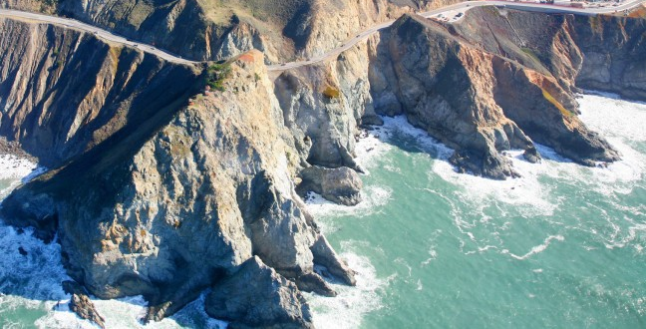
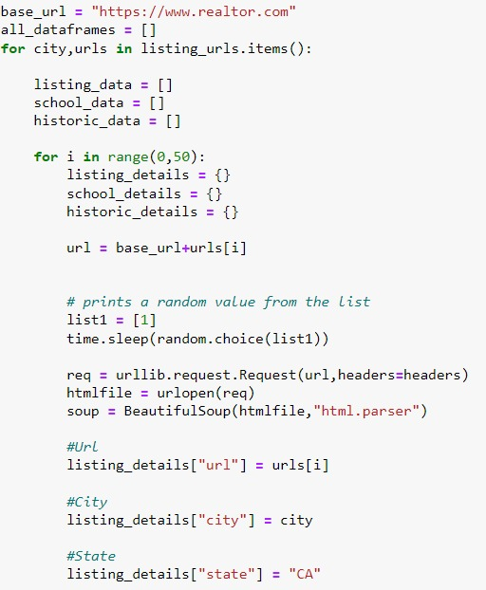
Data Scraping
Website throws “403 Forbidden Error” for scraping more than 50 properties
Scraped 50 properties at a time, city by city.
Exported property data to one csv file.
Changed cookies for each iteration.
Combined each 50-property csv to get a single csv file with raw data.

Slide 5
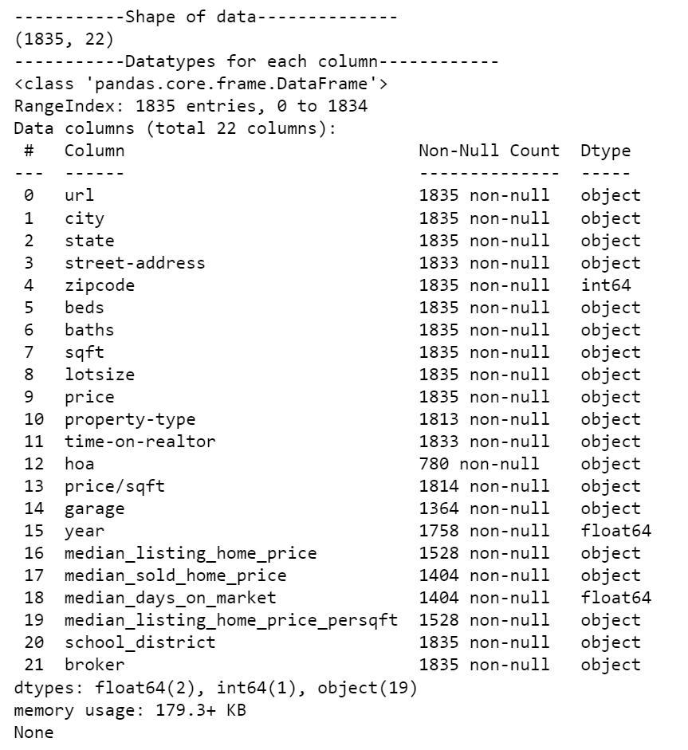
Raw Data
Column Name | Null Value Count
Street address | 2
Sqft | 21
Lot size | 388
Price | 2
Property type | 22
Monthly HOA fees | 1,045
Price per sqft | 21
Parking space | 458
Year of construction | 77
Median home price | 307
Median selling price | 430
Median home price per sqft | 307
Shape: 1835 rows x 20 columns
Duplicate rows: 17
Data types: float, int, object
Notes:
On the right it says lotsize has 0 null values, but upon exploring we found a lot of dashes, zeros, and such.

Slide 6
Data Cleaning
Cleaned text/chars values from numerical value columns like sqft
Converted data type for columns with numerical values
Renamed column names to a single string with underscores
Dropped duplicate rows to get rid of redundant data
Dropped rows with null values in certain important columns
Removed outliers from numerical variables

Slide 7
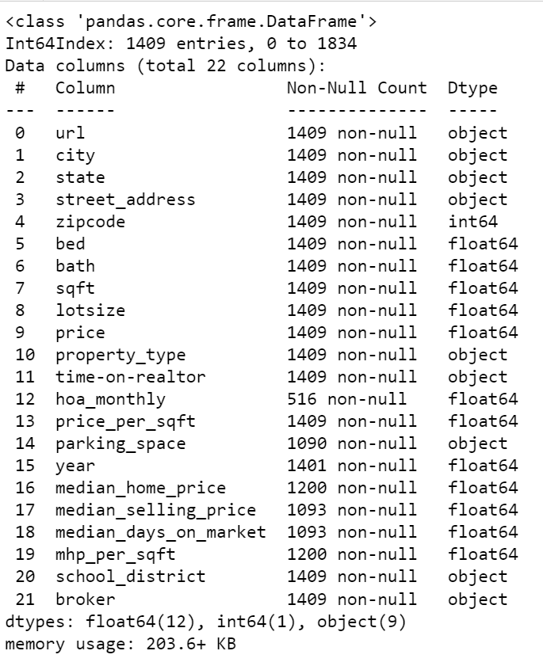
Result - Clean Data
Column Name | Null Value Count
Street address | 0
Sqft | 0
Lot size | 0
Price | 0
Property type | 0
Monthly HOA fees | 893
Price per sqft | 0
Parking space | 319
Year of construction | 8
Median home price | 209
Median selling price | 316
Median home price per sqft | 209
Shape: 1409 rows x 20 columns
Duplicate rows: 0
Data types: float, int, object

Slide 8
General Overview of the Data

Slide 9
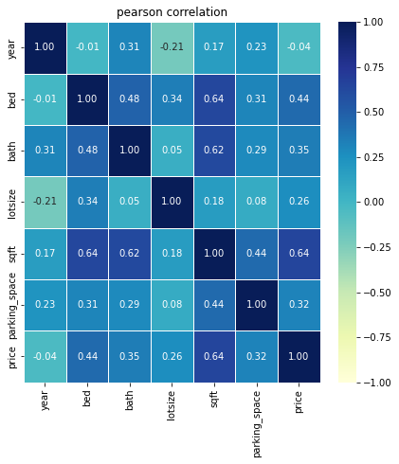
Analyzing Heat Maps
Checking variables that influence price.
Making decisions for next steps of data preparation and analysis.
What we found
Moderate positive relationship between price and number of beds, price and number of bath, price and lot size, price and square feet.
Year the property is built in has no influence on price as it has no relationship.

Slide 10
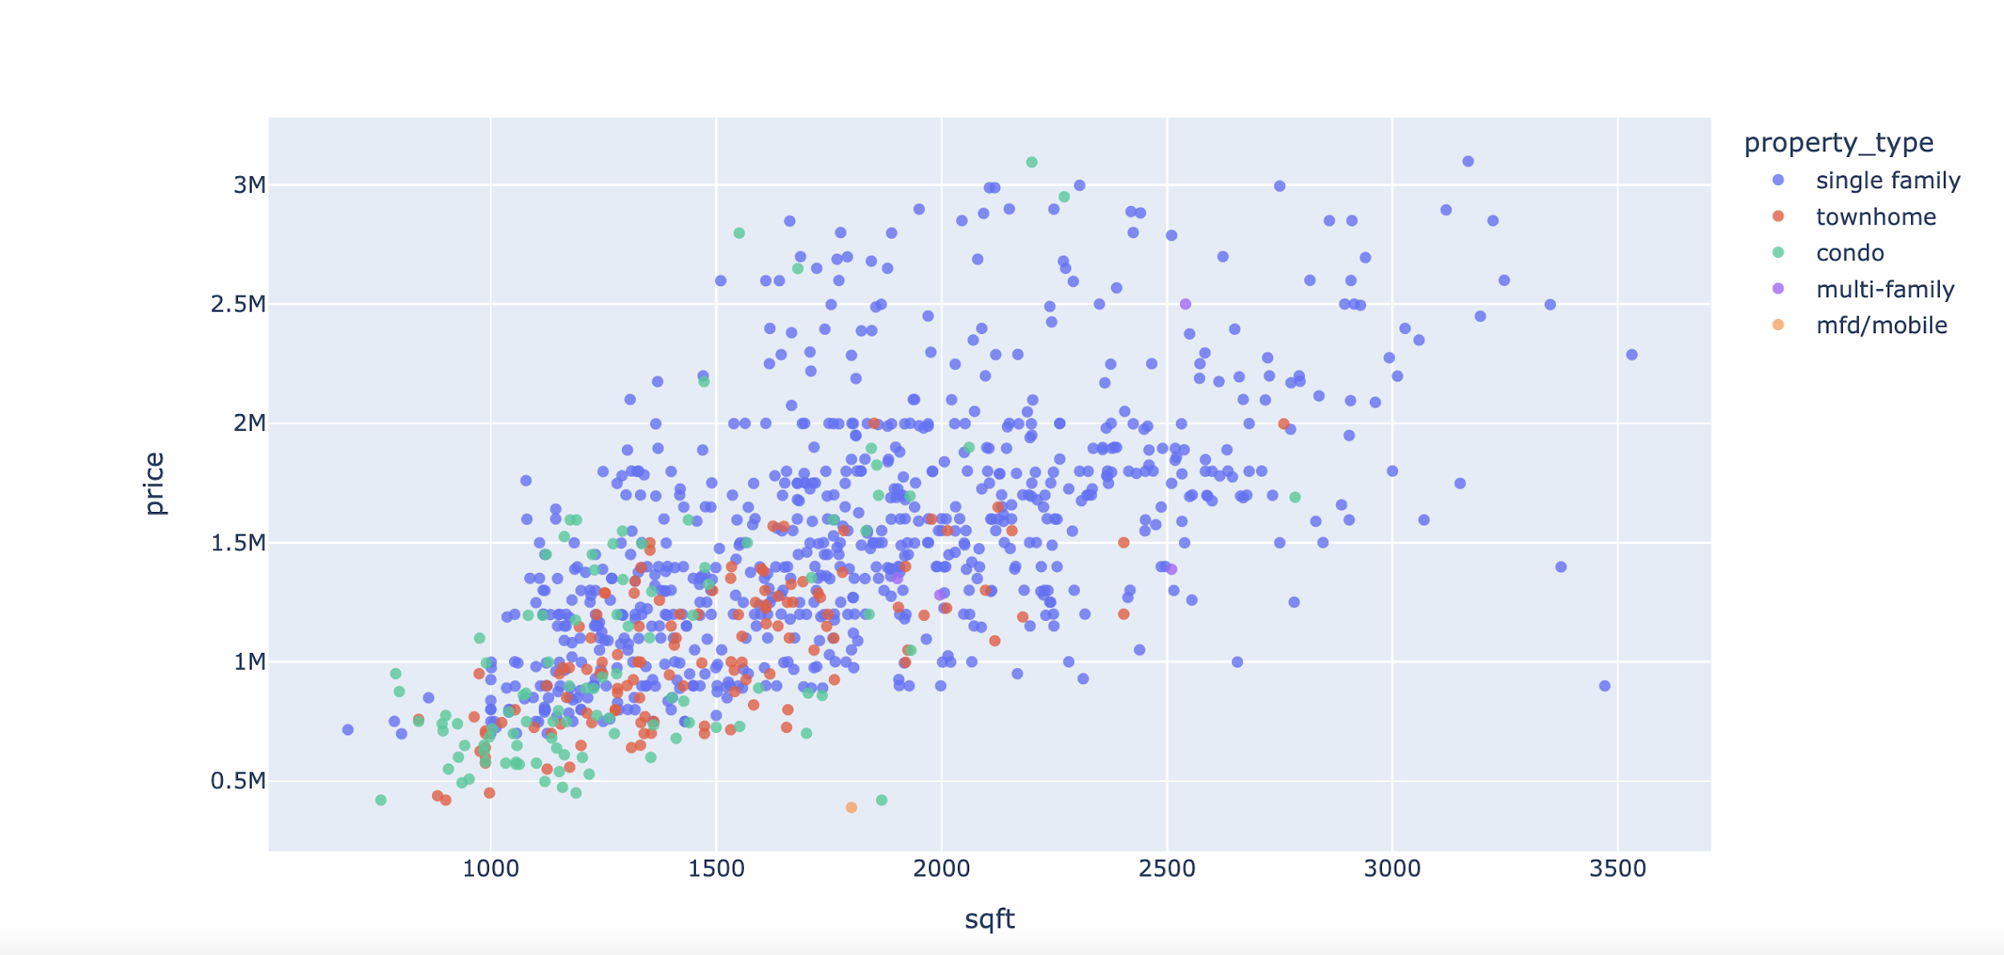
Price and Square Feet
What we found
Positive relationship between square feet and price.
Most listed properties are clustered under the price range of 2M and under 2000 square feet.

Slide 11
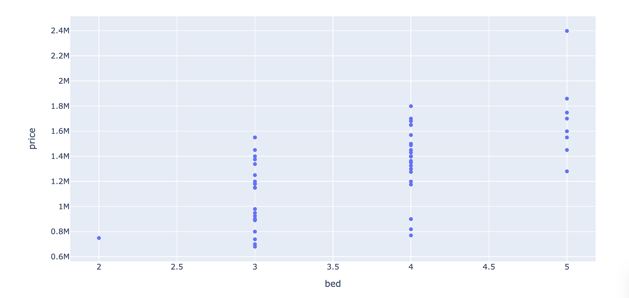
Exploring Union City by Zipcode
What we found
Not many options for 2 or 5 beds.
Lot of properties with 3 and 4 beds.
Wide overlap in price range among properties with 3 and 4 beds.
Properties listed with 3 beds appear to be skewed on both sides of the median.
Properties with 4 beds appears to be right skewed.

Slide 12
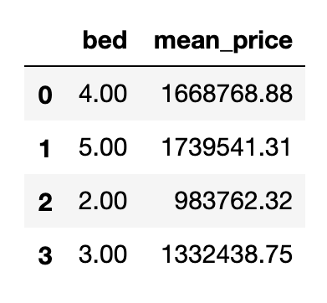
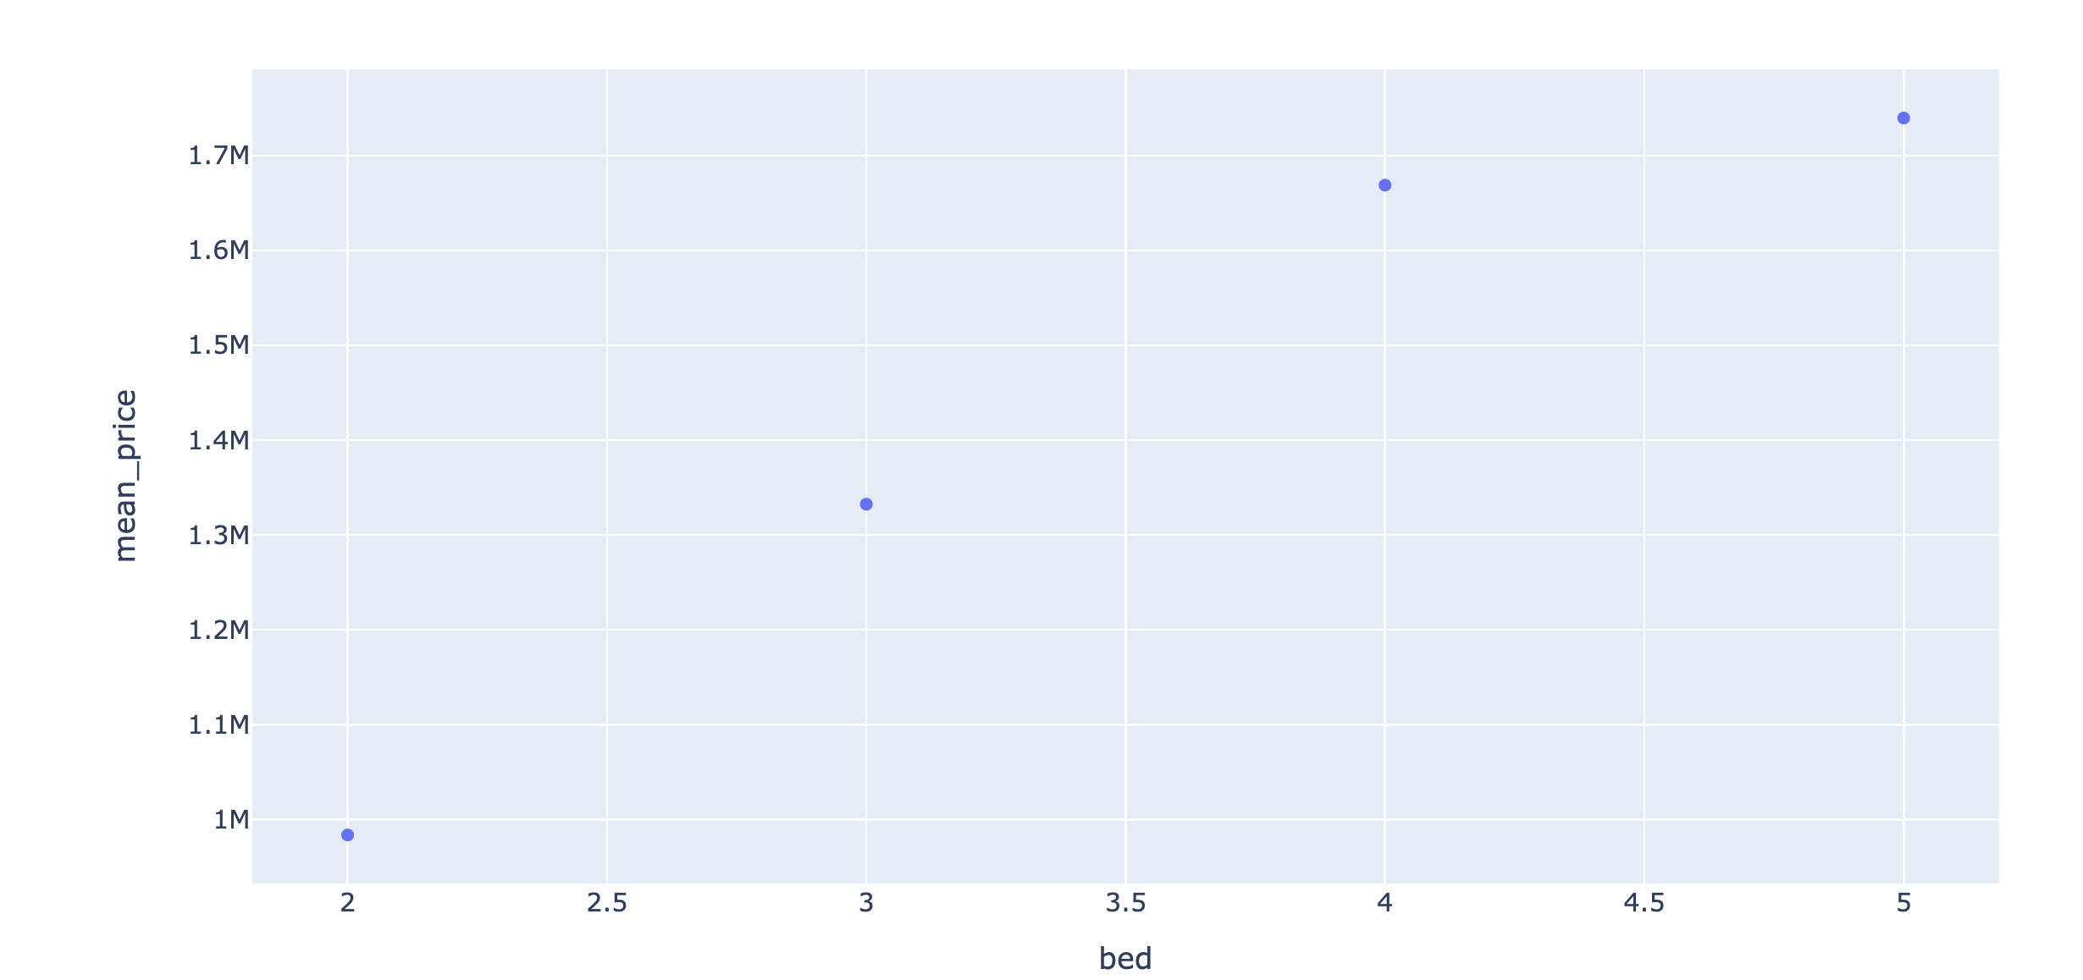
How do prices vary by bed?
Positive relationship between bed and mean price of the properties.

Slide 13
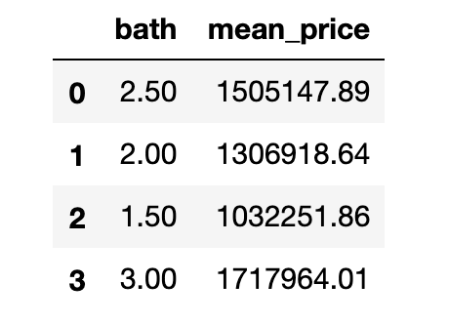
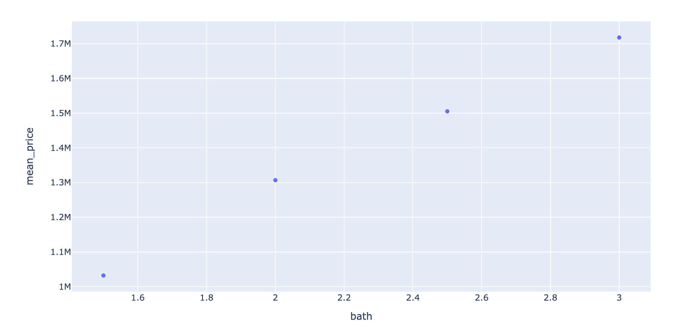
How do prices vary by bath?
Positive relationship between bath and mean price of the properties.

Slide 14
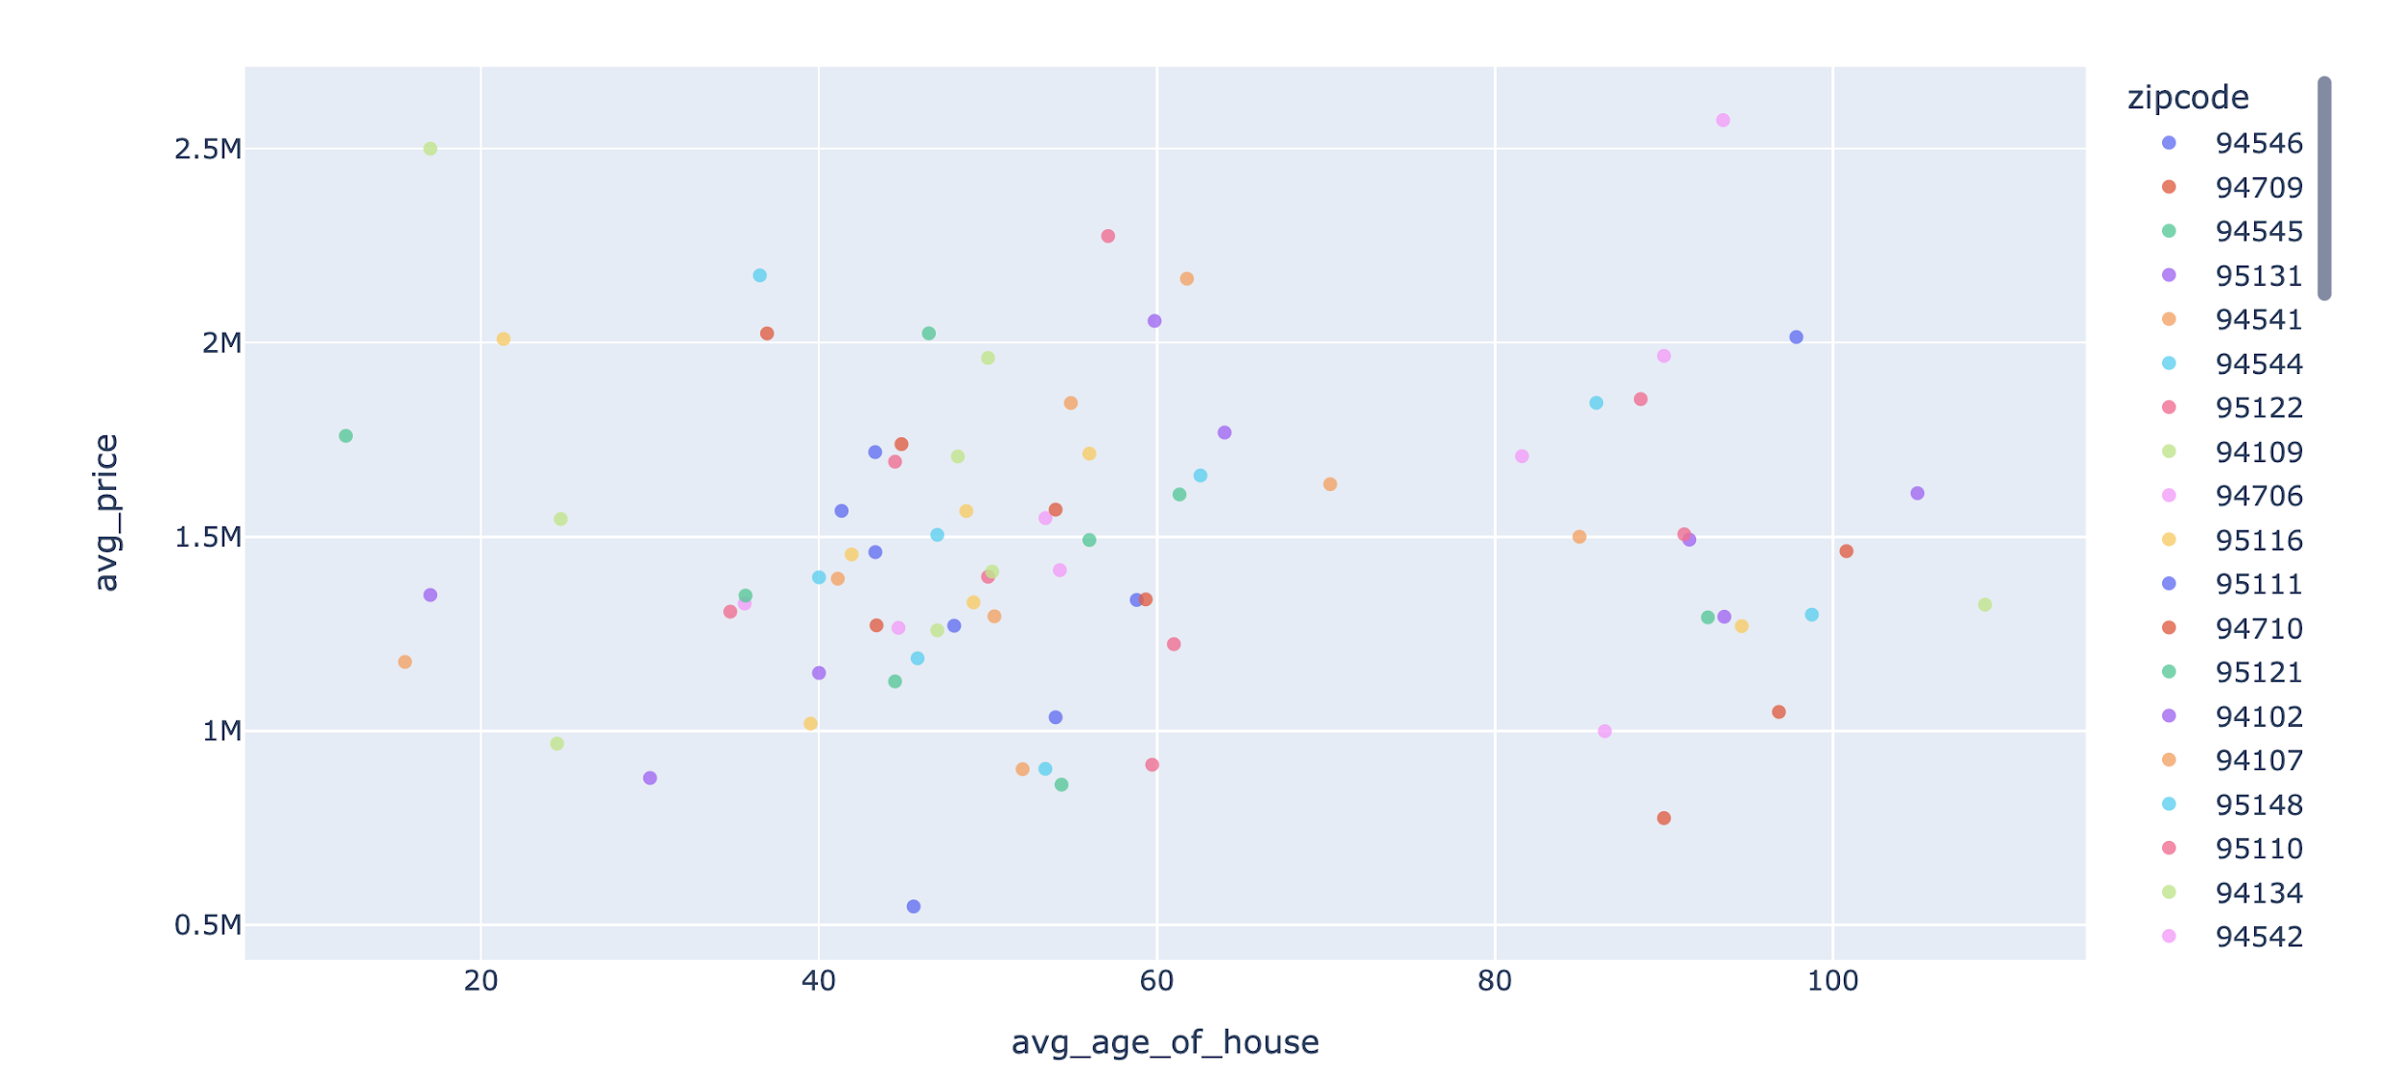
Relationship between year built and price
No relationship between the price and the year the property is built in.
Fun Fact:
Not many properties were built around 1950s - specifically between age 60 and 80. This could be because of war that took place in 1950 or any other factor.

Slide 15
Hotspots in East Bay

Slide 16
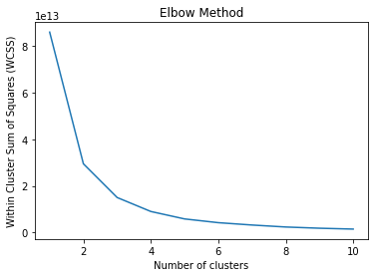
K-Means Clustering
Filtered only those listings that fall under East Bay - Fremont, Hayward, Union City and Berkeley
k-means based on price, number of bedrooms and number of bathrooms
Identified the ideal number of clusters using the elbow method
Properties by cluster:
0B, 1B, 2B, 3B, 4B, 5B, 6B

Slide 17
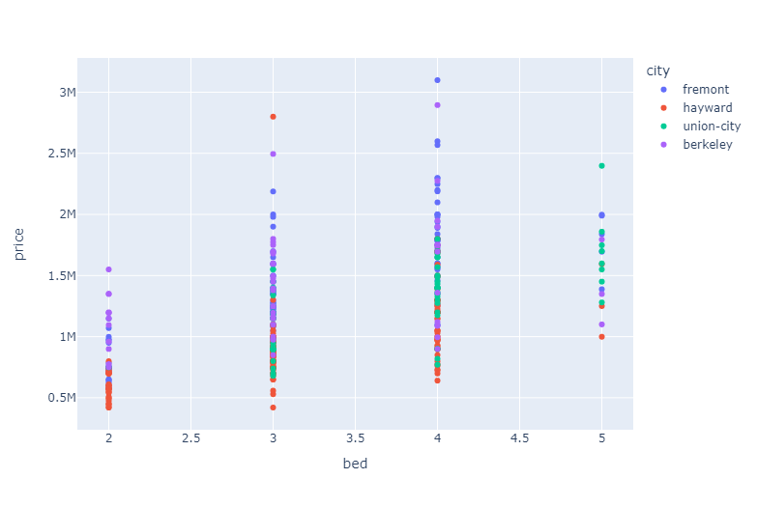
So, what are the hotspots in East Bay?

Slide 18
Comparing Properties in San Francisco Bay Area and Other Cities

Slide 19
Getting new data
Cities: Boston, Chicago, Austin, Seattle, Los Angeles
Scraped data (price related columns only) to compare pricing
Performed data cleaning steps(remove duplicates, null, outliers)
Data Analysis
Calculated average price per sqft for each city
Compared price per sqft for all cities

Slide 20
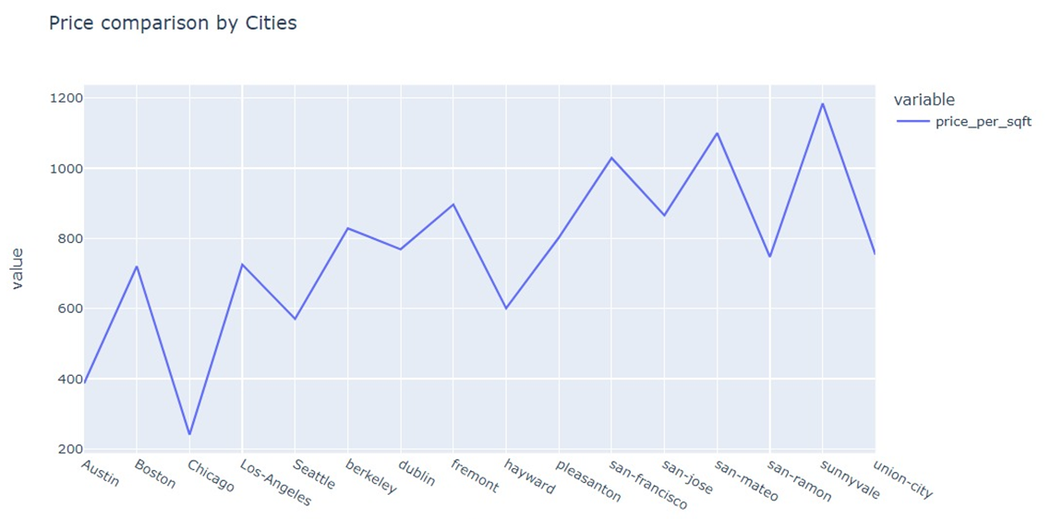
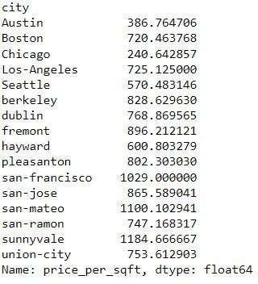
SF Bay Area Cities vs Other Big Cities

Slide 21
What we found
Sunnyvale, San Mateo and San Francisco have the highest property prices
Property prices in other bay area cities are comparable with prices in Boston and Los Angeles
Hayward properties are cheapest in bay area and comparable to Seattle prices
Austin and Chicago have lowest property prices

Slide 22
Regression Analysis

Slide 23
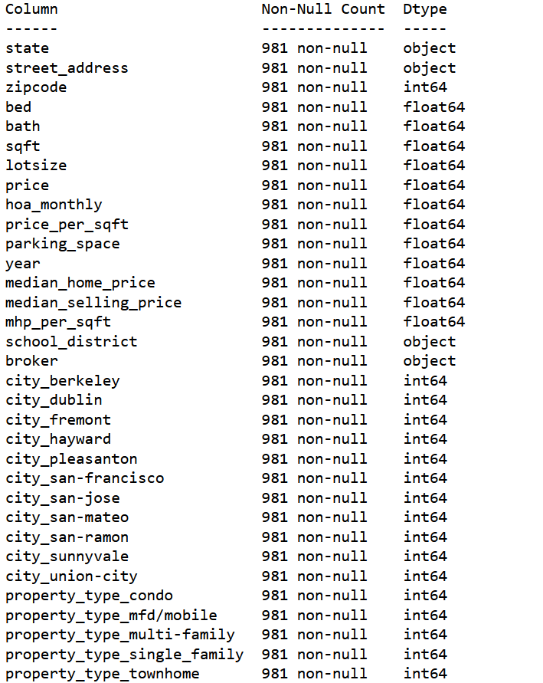
Missing Values
Replaced missing values with mean (parking space & year) and median (median home price, hoa monthly, median selling price, and mhp per sqft) as the prediction model will not perform well with missing values.

Slide 24
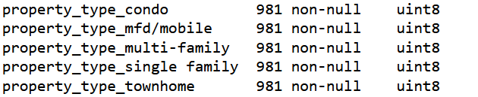
Categorical Data: One-Hot Encoding
Property type contains categorical data which should be encoded using one-hot encoding method using dummy values and concatenated to the main dataframe.

Slide 25
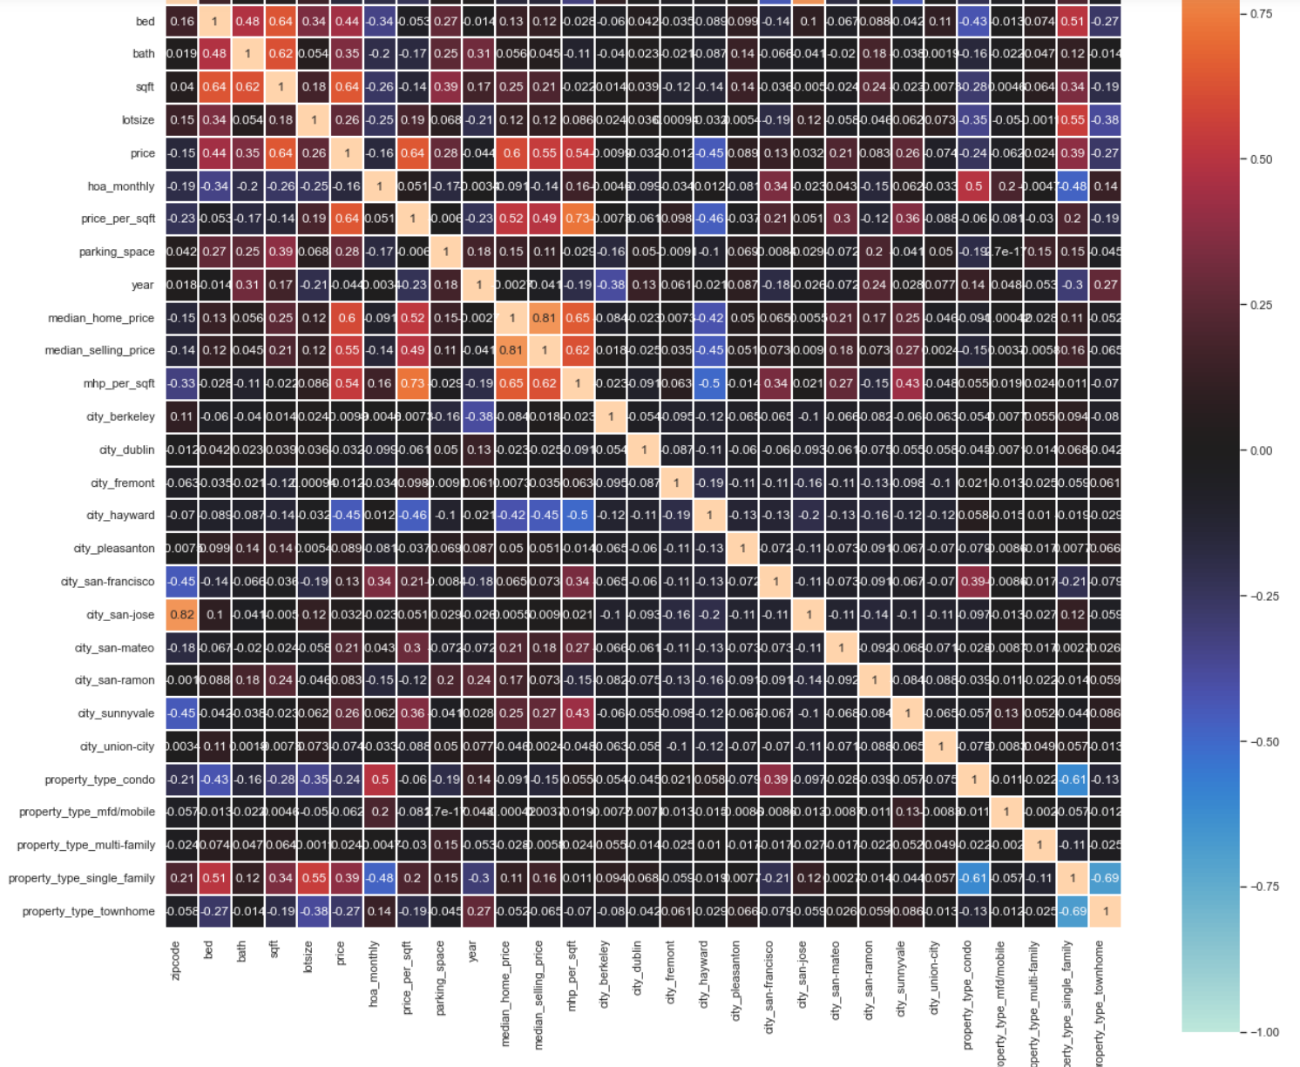
Predictors & Outcome Variable
Using the correlation heatmap, identified and eliminated those variables dependent partially or completely on price.
The predictor variables are:
zip code
lot size
parking_space
year
property_type_condo
property_type_single-family
property_type_multi-family

Slide 26
Prediction: Train-Test Split
Data Division:
Training Data: 75 %
Test Data: 25 %

Slide 27
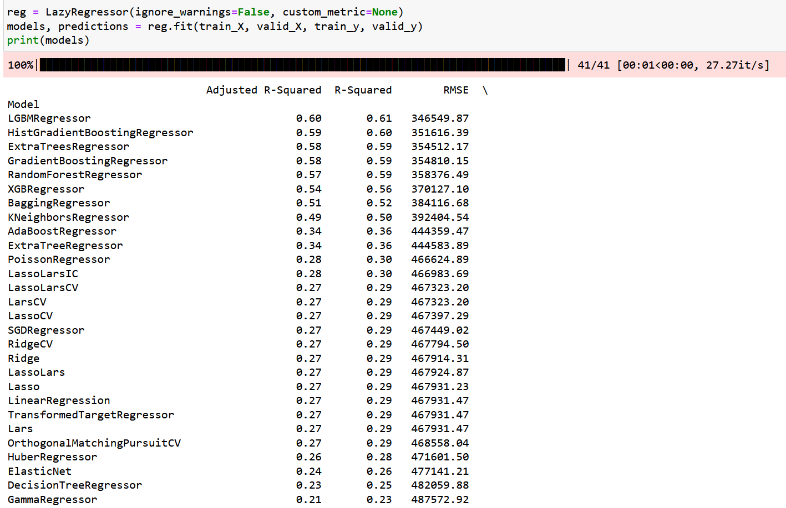
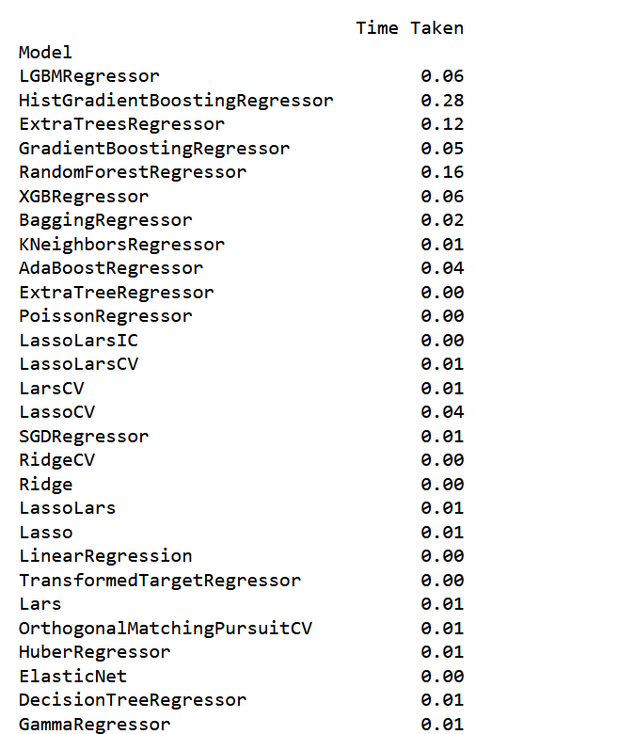
Analysis of different models using Lazy Predict
Lazy Predict contains 41 different regression vanilla models which predicts the outcome with metrics such as R-squared value, RMSE value and the time taken for each model to run.

Slide 28
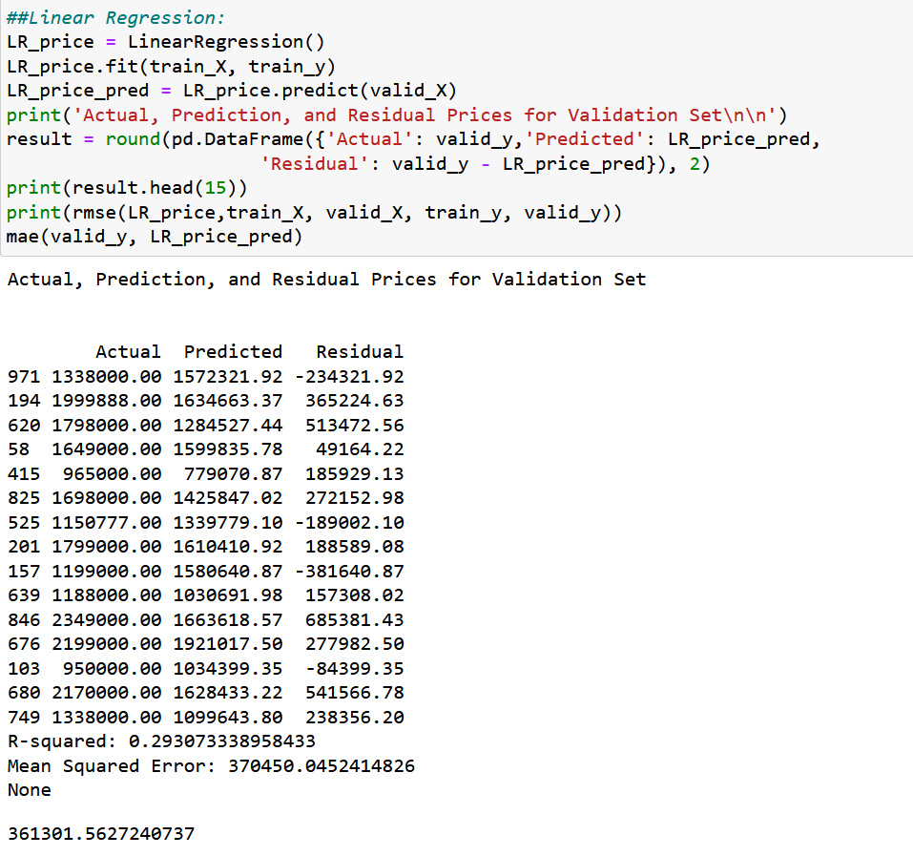
Model 1: Linear Regression
R-Squared Value = 0.29
MSE = 370450
MAE = 361301

Slide 29
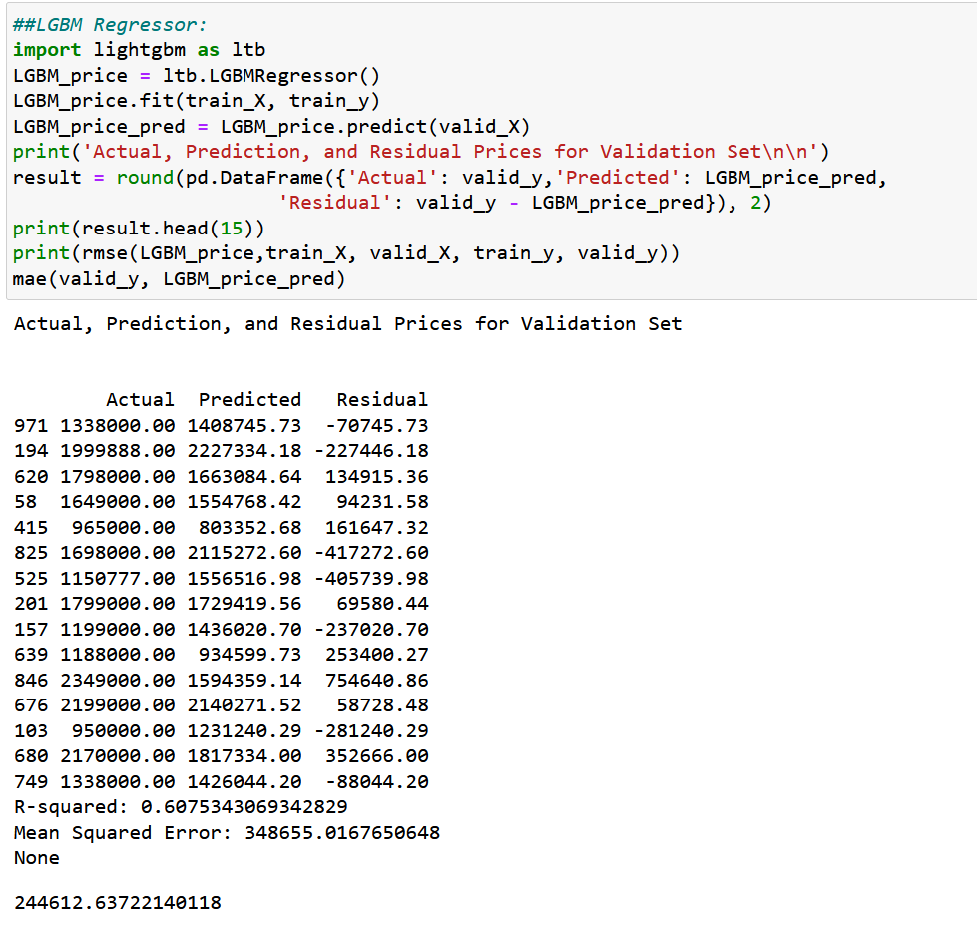
Model 2: LGBM Regressor
R-Squared Value = 0.61
MSE = 348655
MAE = 244612

Slide 30
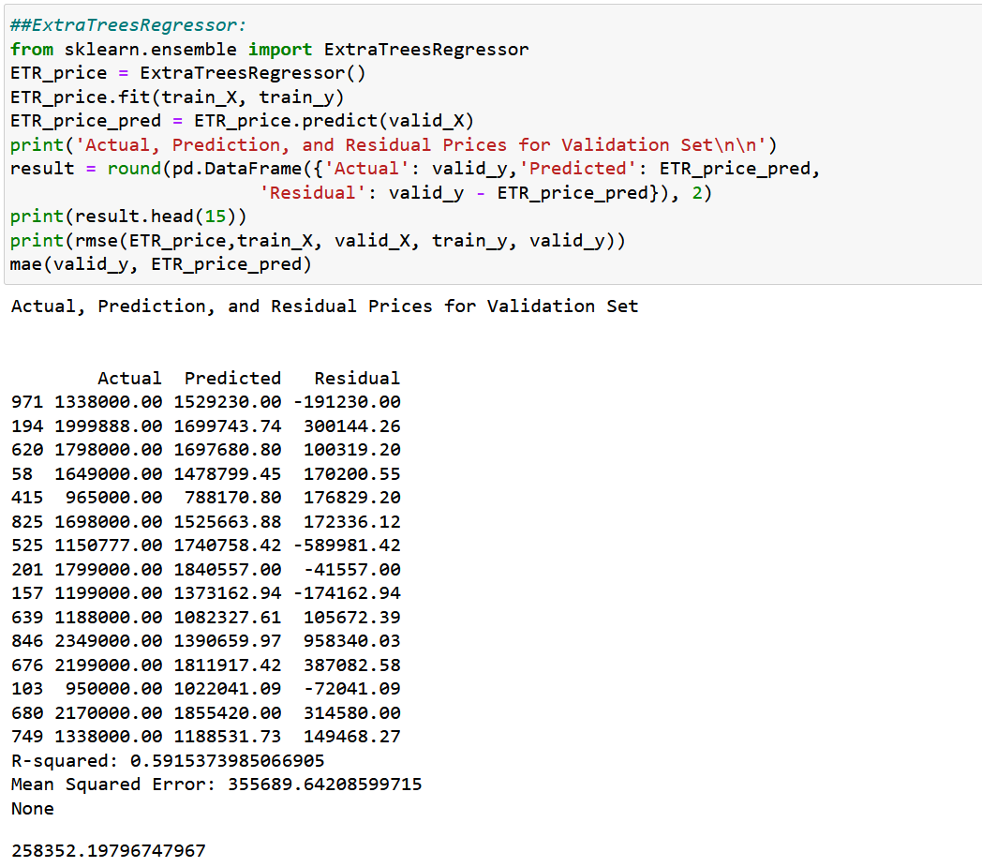
Model 3: Extra Trees Regressor
R-Squared Value = 0.59
MSE = 355689
MAE = 255340

Slide 31
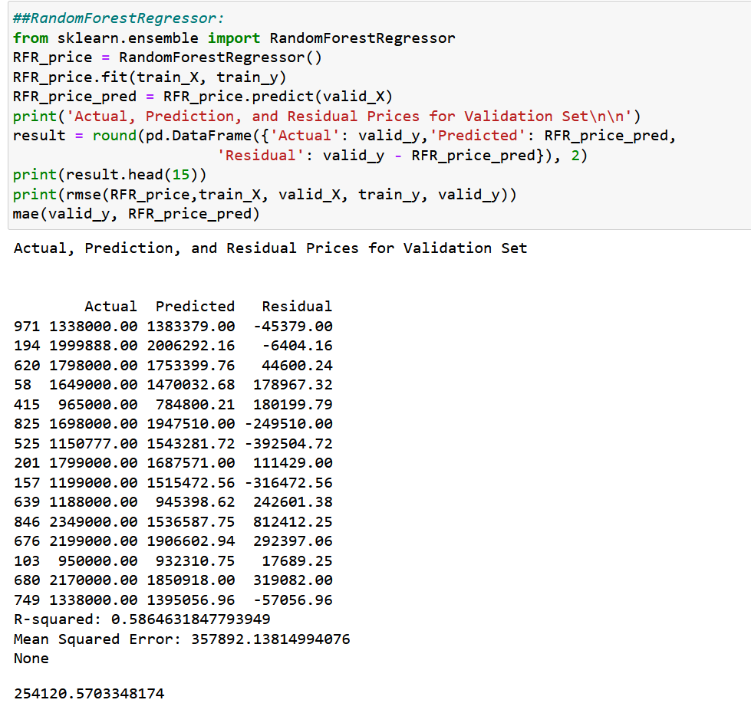
Model 4: Random Forest Regressor
R-Squared Value = 0.58
MSE = 357892
MAE = 253929

Slide 32
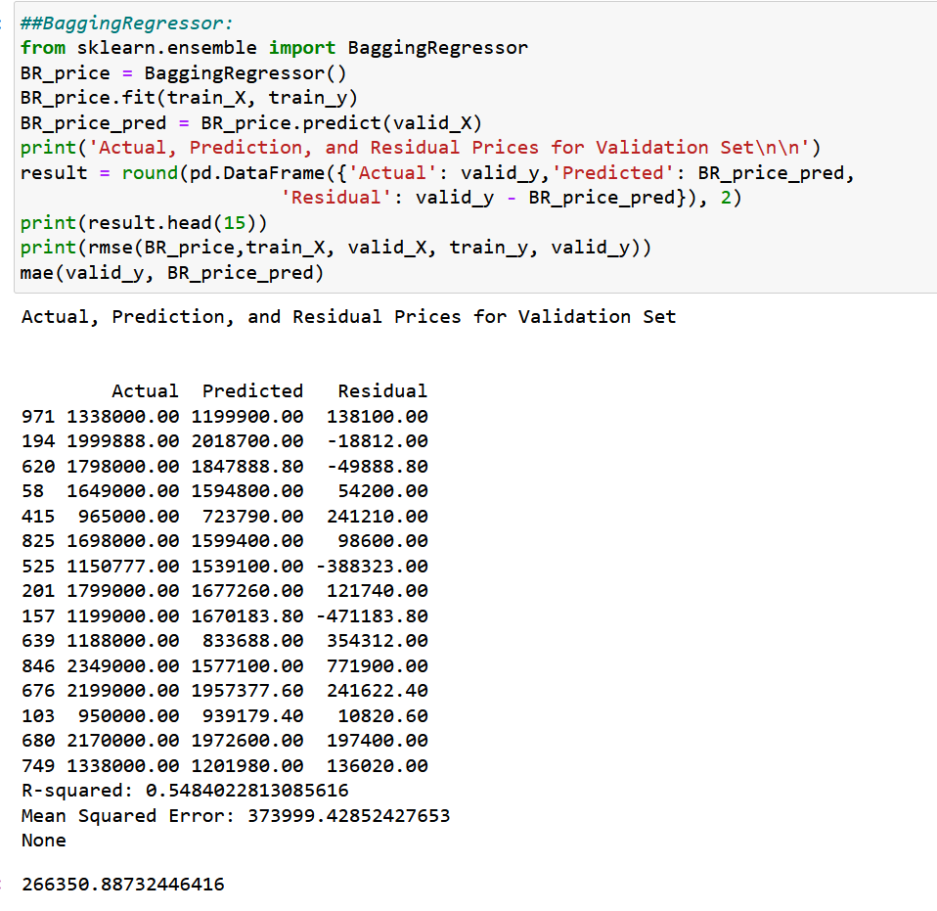
Model 5:
Bagging Regressor
R-Squared Value = 0.59
MSE = 373999
MAE = 252078

Slide 33
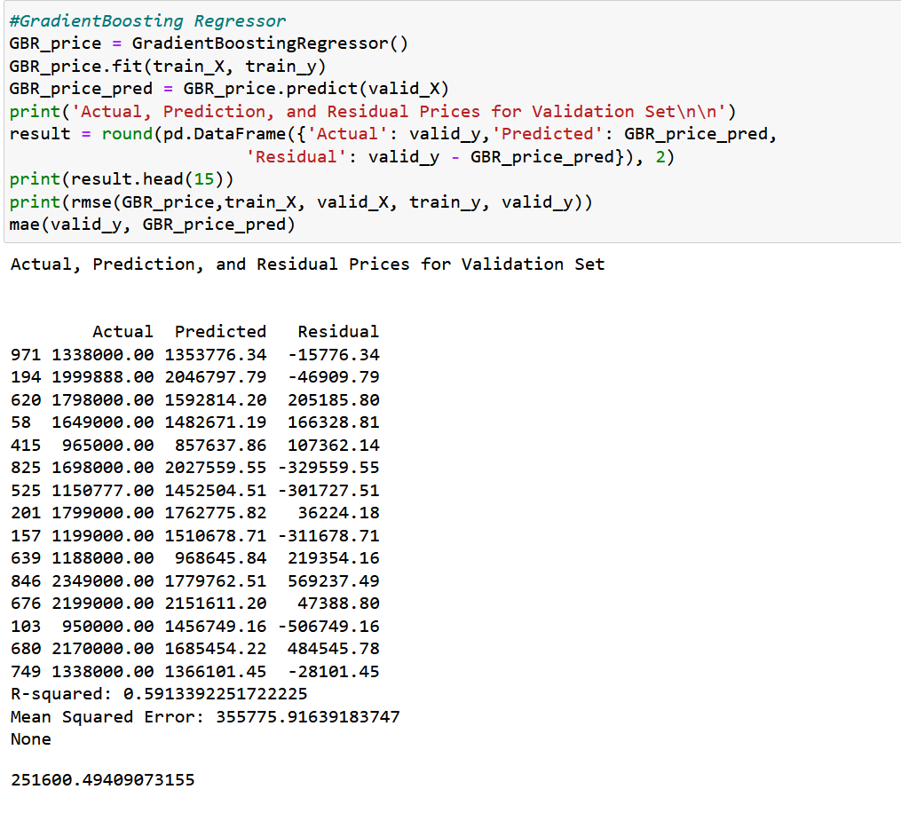
Model 6:
Gradient Boosting Regressor
R-Squared Value = 0.59
MSE = 355775
MAE = 251751

Slide 34
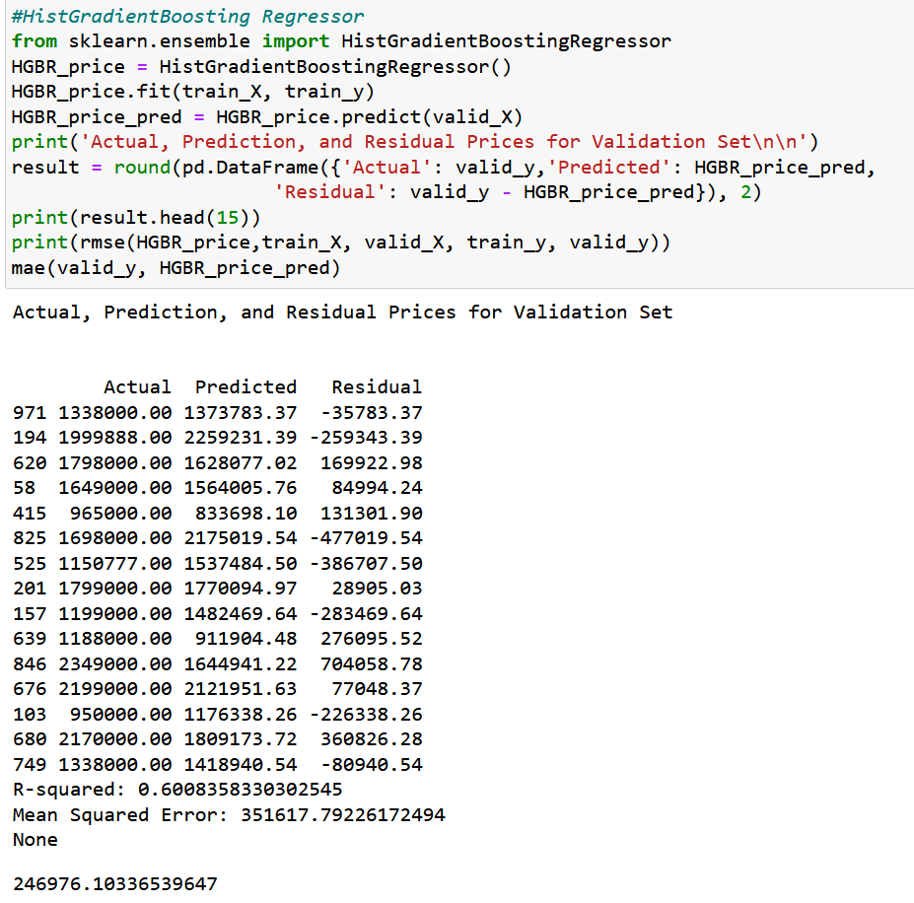
Model 7:
Histogram-based Gradient Boosting Regressor
R-Squared Value = 0.60
MSE = 351617
MAE = 246976

Slide 35
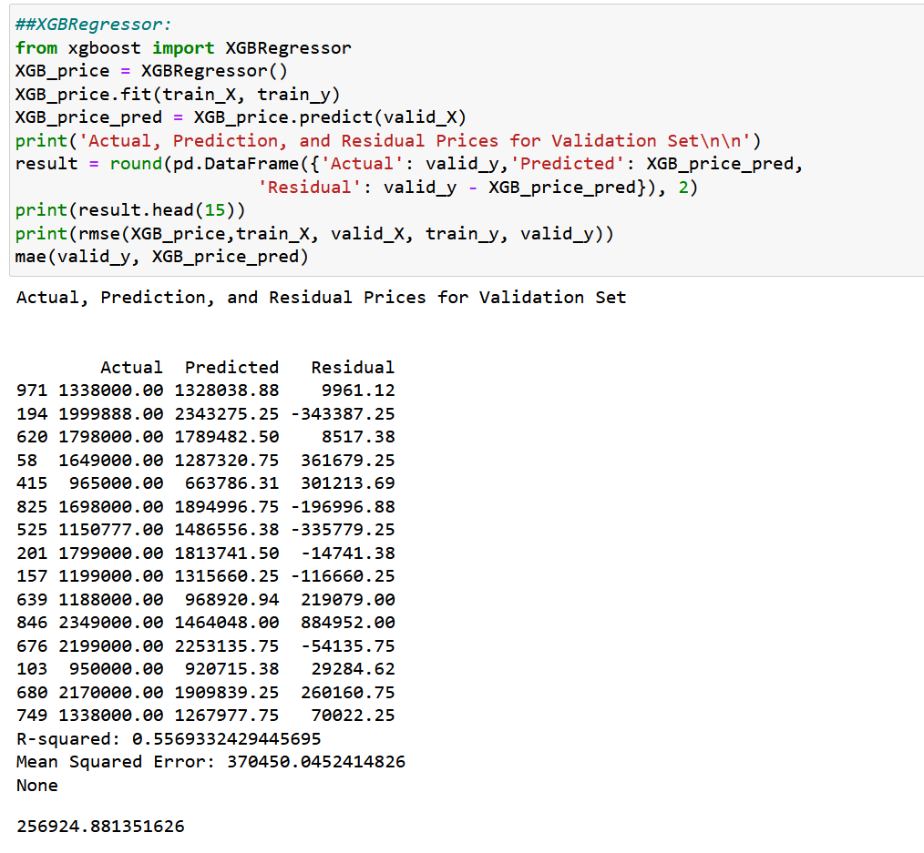
Model 8:
XGB Regressor
R-Squared Value = 0.55
MSE = 370450
MAE = 256924

Slide 36
Factors considered when choosing the best model
R-squared value: Explains the variance of the dependent variable (higher the better).
Mean Squared Error: Lower the mean squared error, better the model.
Mean Absolute Error: Lower the mean absolute error, better the model
Time taken: Time taken for the model to predict the outcome.

Slide 37

Conclusion: Best Model
LGBM Regressor as it has:
R-squared value of 0.61 which means the independent variable can explain 61 % of the variance of the dependent variables.
Mean Absolute Error is 244612 which the least value compared to the other models.
Mean Squared Error is 348655 which is the least value compared to the other models.
Time taken is 6 seconds which helps to save computational costs.

Slide 38
Questions ?

Slide 39
Thank You!
Group 4
Aishwarya Khinvasara
Nihal Jayan
Rahul Chada
Ruchika Balani
Swetha Srinivasan

